Slide 1

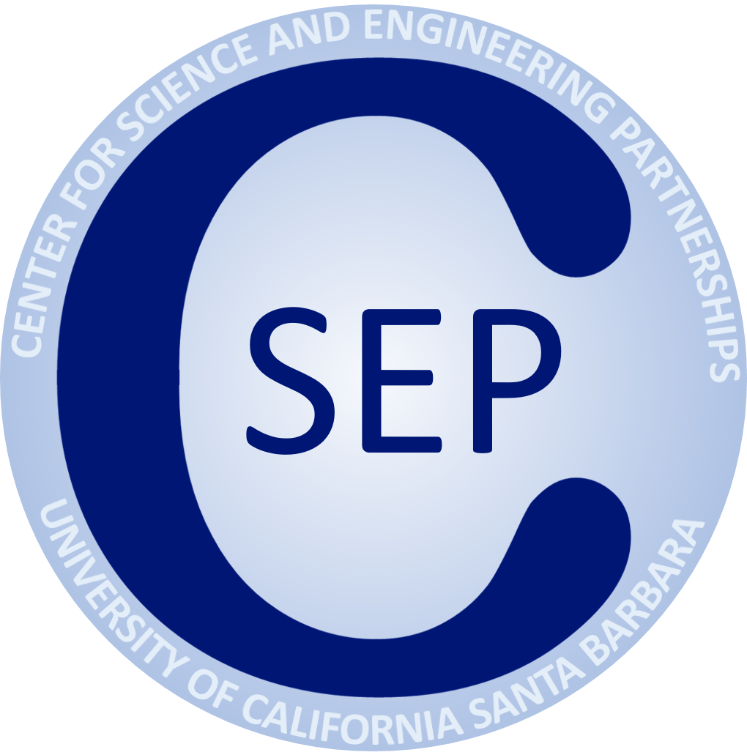

Electro-Optic Modulators at Cryogenic Temperatures
Andrew Yanez
Mentor: Sahil Patel
Professor: Galan Moody
1
Notes:
Hi my name is Andrew Yanez, I have had the privledge of researching in the QPL under mentor Sahil Patel and professor Galan Moody. We work on developing photonic circuits for quantum applications.

Slide 2
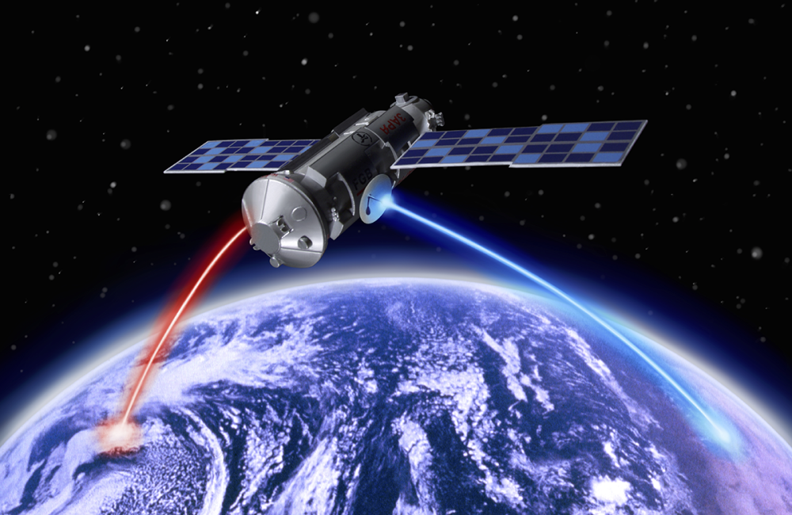



Motivation
2
Notes:
1) Enabled by photonic Technologies
2) Starlink investing, greater coverage
3) It is necessary to be able to modulate or change light
4) We are collaborating with a company called Lucidean size, weight, power, and cost
5) Characterizing these devices
Currently the global internet infrastructure is enabled by photonic technologies, companies like Starlink are investing in satellite based communication which enables faster data communication rates and greater coverage. To further advance satellite-based communication technologies it is necessary to have integrated optical components that can encode information by modulating light. In EOM, there is a photonic component to do just this. We are collaborating with a company Lucidean, who is developing the next generation of modulators with an increased robustness, such as with size, weight, power, and cost. My work this summer consisted of characterizing these devices for use and applications in cryogenic environments.

Slide 3
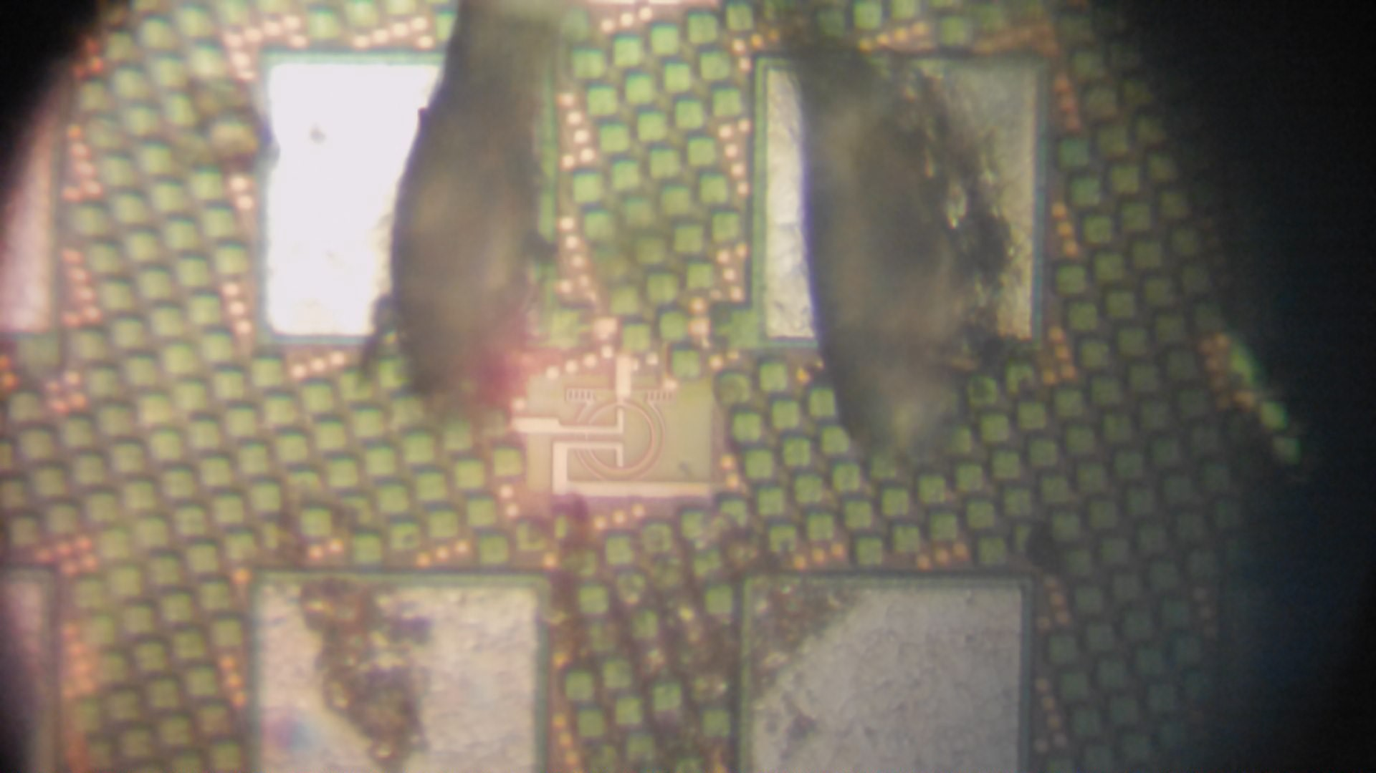
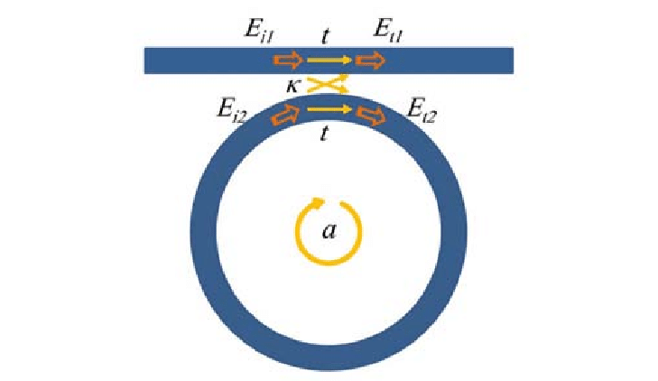
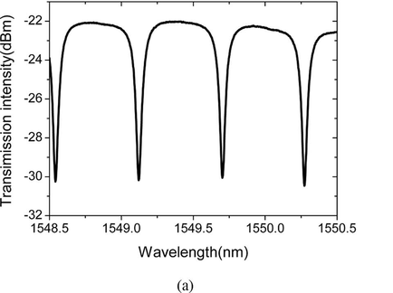
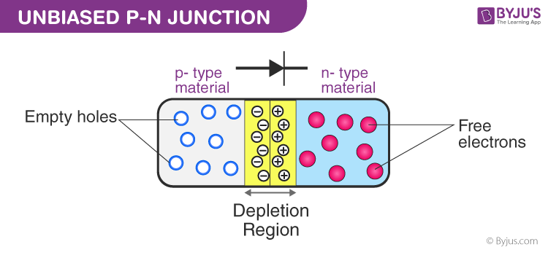
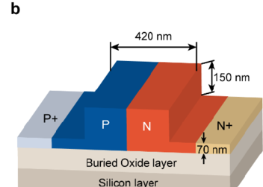
What are Electro-Optic Modulators?
Microring
Resonator
3
Notes:
This is an image of what our device looks like under a microscope. Effectively what this is a ring resonator and P-N junction combined into one device.
Ring Resonator:
Waveguide structure in which you send in light. Some light couples into the ring. Some light constructively interferes and some destructive interference. When it goes through the top waveguide we measure to see the light that comes through. When it goes through the ring resonator the light does not reach our measurement which is why there is a dip. This is called resonance. These resonances can be used to encode information and can send data across long distances. If we want to modulate the data, all we want to do is shift the resonance. Essentially what this means is to shift the valleys, either a little bit to the left or a little bit to the right.
P-N Junction:
This in inside the ring resonator. If we hook up a battery to supply a voltage to the junction, current would flow from left to right, creating an electric field that shifts our resonance dip.
On the right, this is a cross section of the r

Slide 4
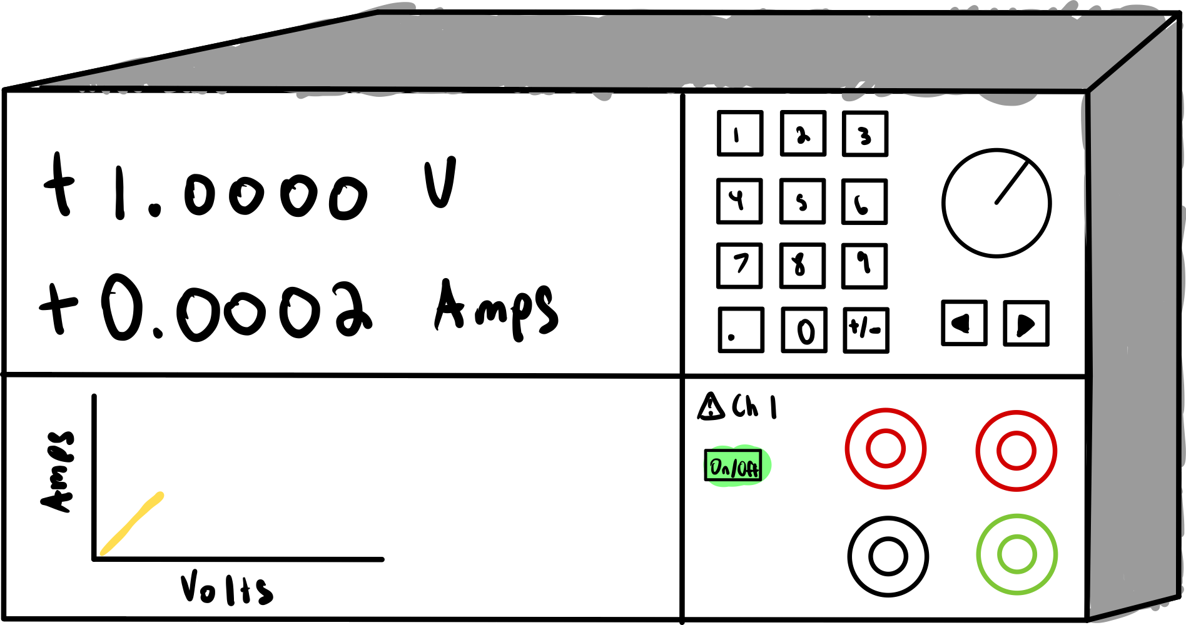
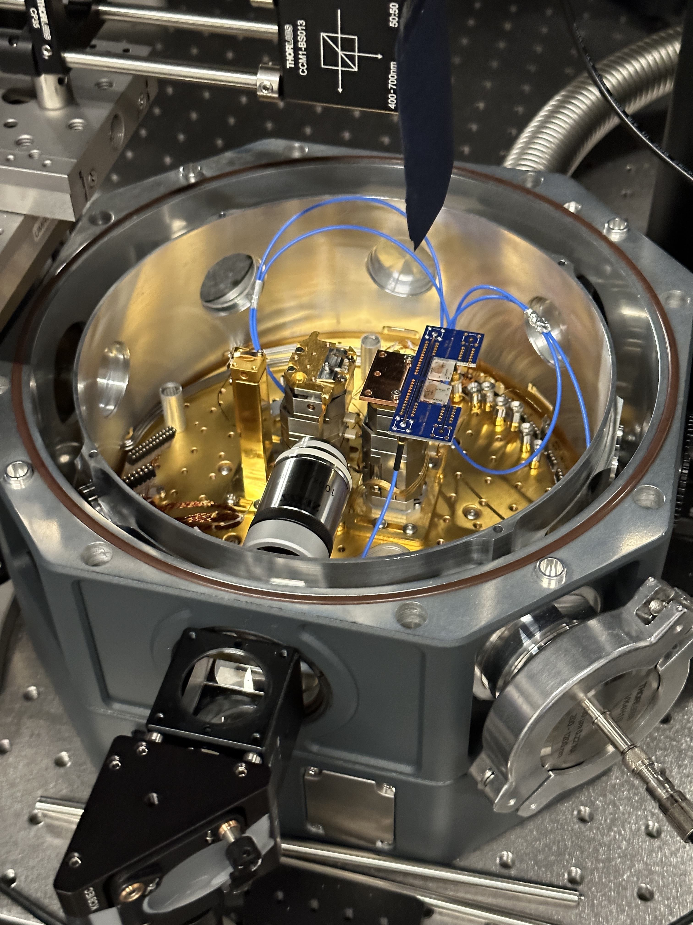
Lab Setup
Voltage Sweep
Cryostation
4
Notes:
4k Temperatures
Microscope Objective
Beam Splitter
Blue Wires to send Voltage
It has a PCB on the nano-positioner
All we care about is the cold plate that gets it to 4 k temperatures

Slide 5
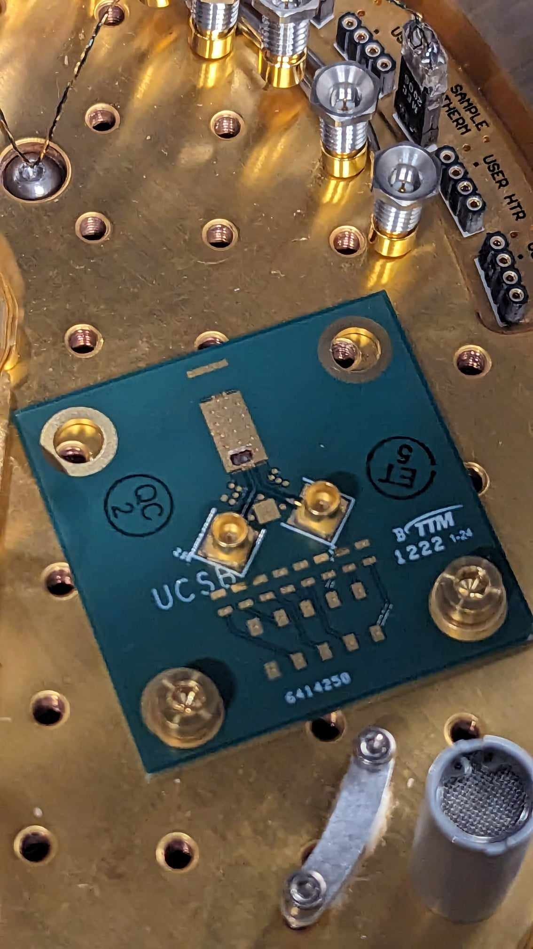
Lab Setup
Chip
Voltage Sweep
Electro-Optic-Modulator
5
Notes:
This is what the sample looks like
Electro-optic co-packaged
Put an arrow to tiny chip

Slide 6

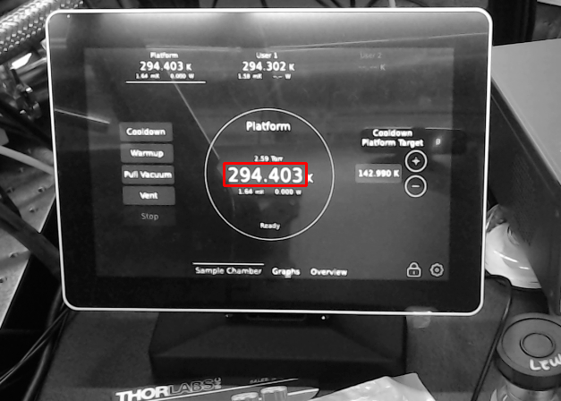
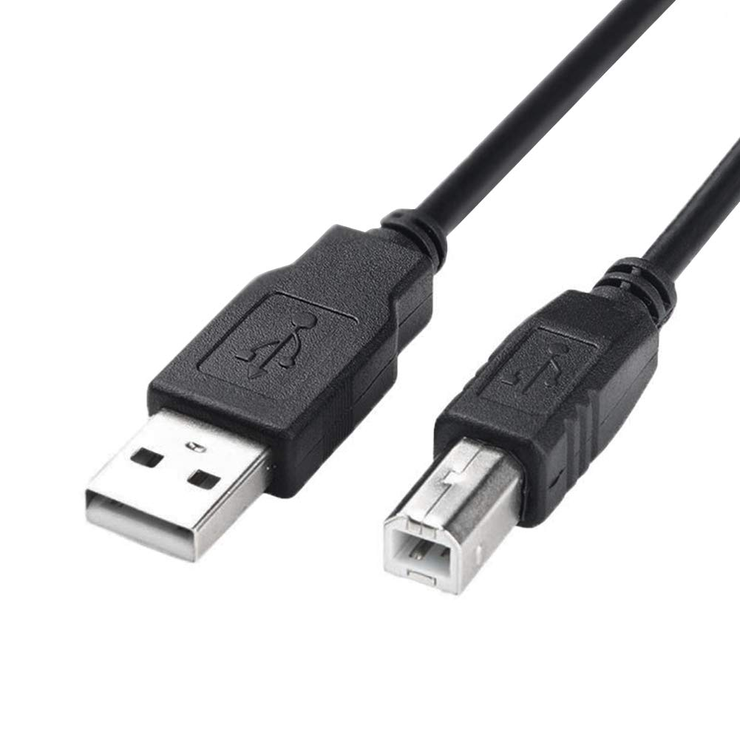
How do we measure temperature?
6
Notes:
This is where we get all of the laughs:
1) Screen connect cryostat
2) How read screen?
3) Like normal, just hook it up to usb and download CSV file.
5) Not how it works, research is just interface device

Slide 7
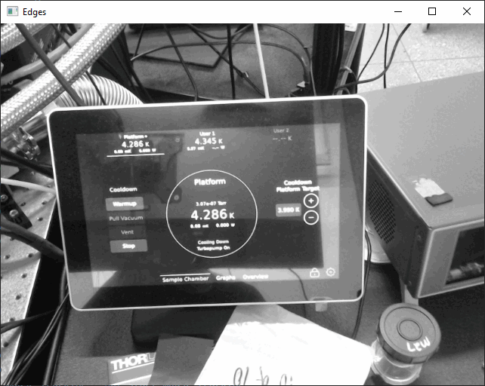
Temperature Readings
Resize Window
While
Edge Detection
Voltage Sweep
7
Notes:
Have video or gif of how it uses edge detection
Talk about edge detection
Pseudo Code Diagram

Slide 8

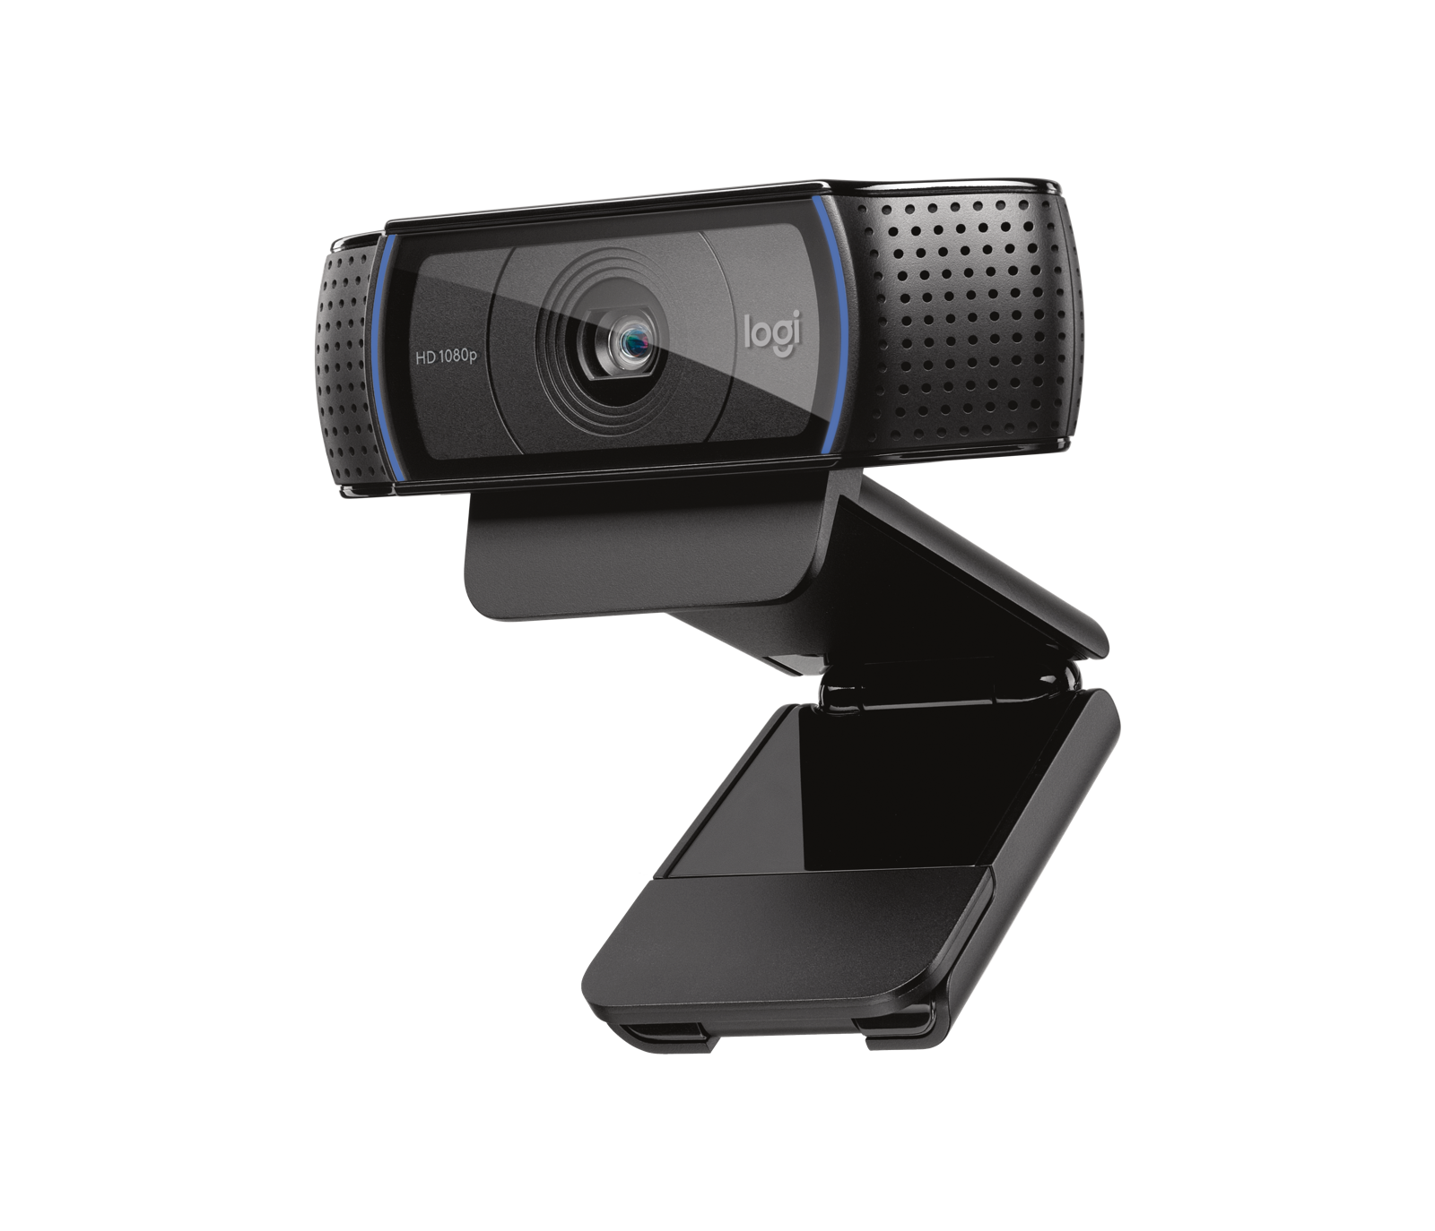
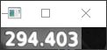
Temperature Readings
8

Slide 9
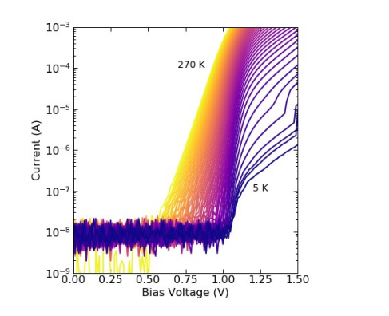
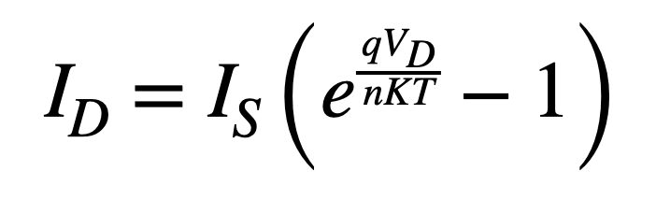
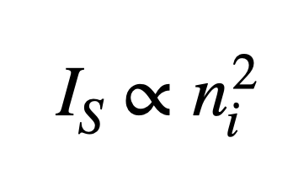
Prior Results
Electro Absorption Modulator (Previous Work)
Estrella, S. B. (2022). Silicon photonics for harsh environments
9
Notes:
Negative Charge
Carrier Freeze Out
When the temperature is decreased the electrons go from the conduction back down to the doped state
And then Show results’
Carrier Concentration goes down
I_s goes down
I_d goes down
Which is what we see in our plot at 5k
Diode current
Saturation Current:
Essentially just current that flows in a diode when it's in reverse bias

Slide 10
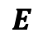
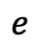
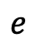
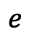
Prior Results
Electro Absorption Modulator (Previous Work)
$$E$$
Conduction Band
$$e$$
$$e$$
$$e$$
Doped State
Valence Band
Estrella, S. B. (2022). Silicon photonics for harsh environments
9
Notes:
Negative Charge
Carrier Freeze Out
When the temperature is decreased the electrons go from the conduction back down to the doped state
And then Show results’
Carrier Concentration goes down
I_s goes down
I_d goes down
Which is what we see in our plot at 5k
Diode current
Saturation Current:
Essentially just current that flows in a diode when it's in reverse bias

Slide 11
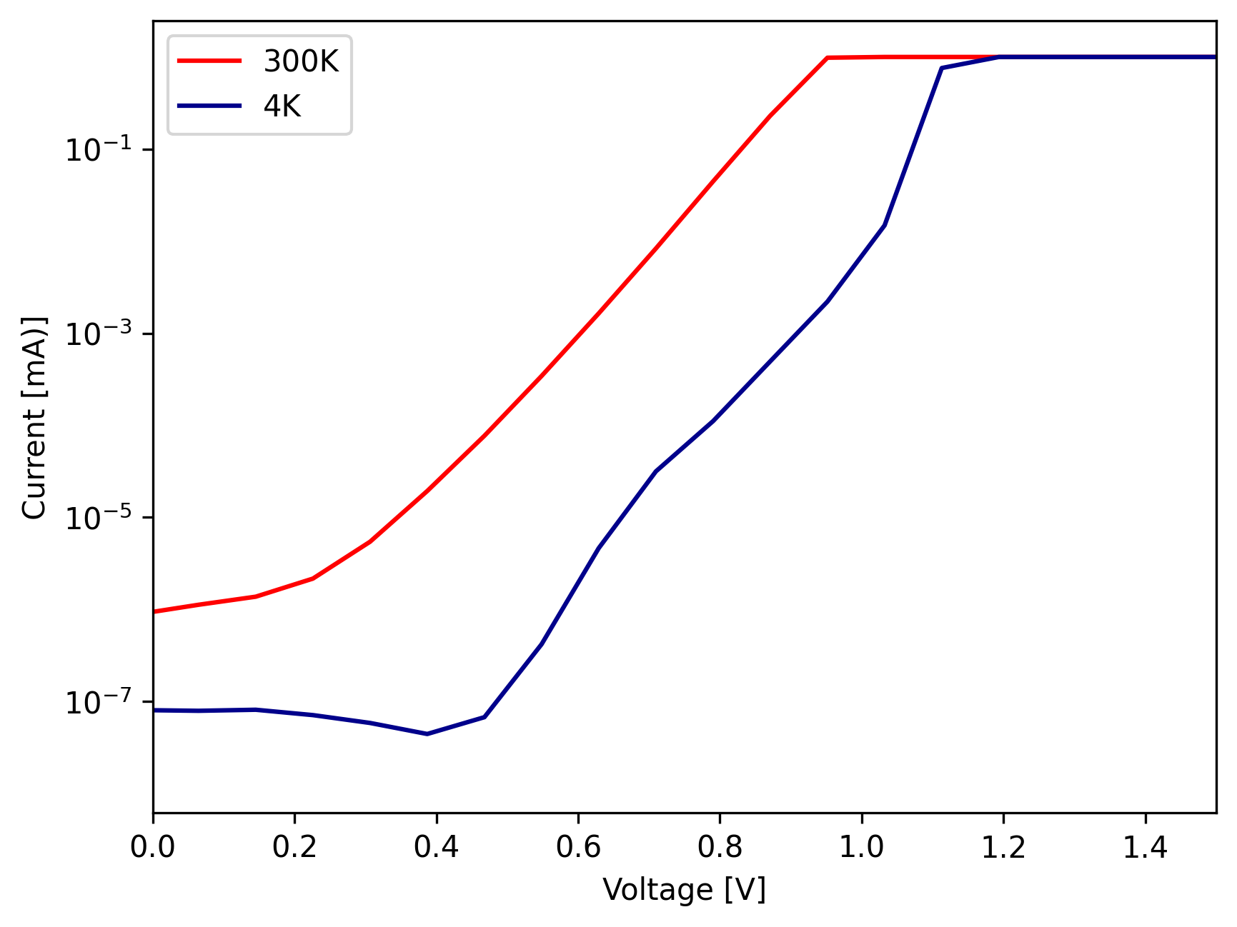
My Results: P-N Junction
Electro Optic Modulator
10
Notes:
The saturate happens, we don’t know why
We are in the process of troubleshooting and trying to troubleshoot our data

Slide 12
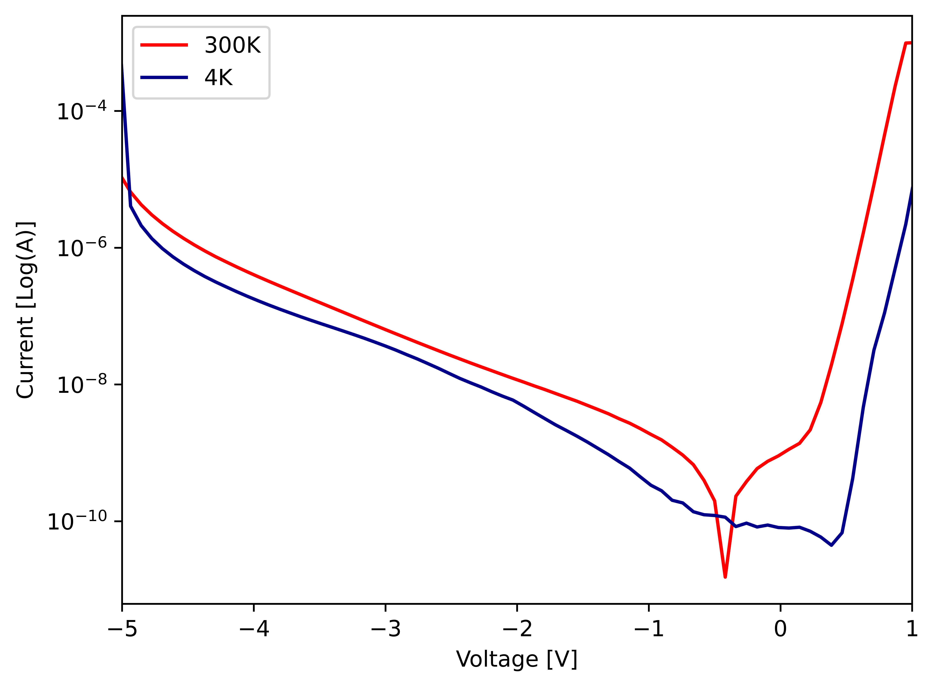
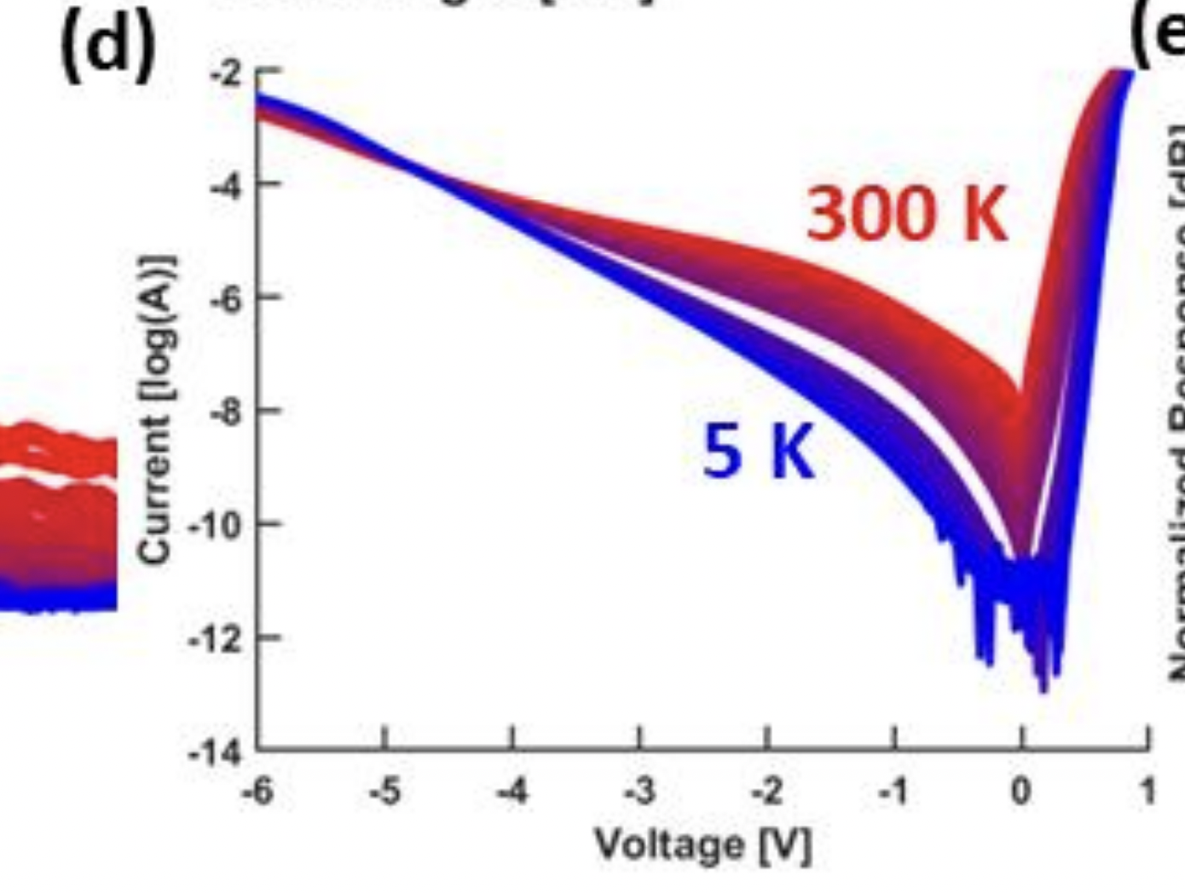
Results: Reverse Bias Sweep
My Results
Prior Results
E. Chansky et al., "High-Speed SiGe EAMs at Cryogenic Temperatures,"
11

Slide 13
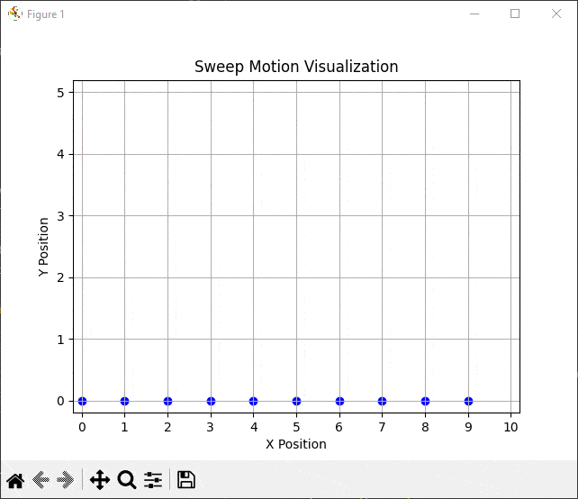
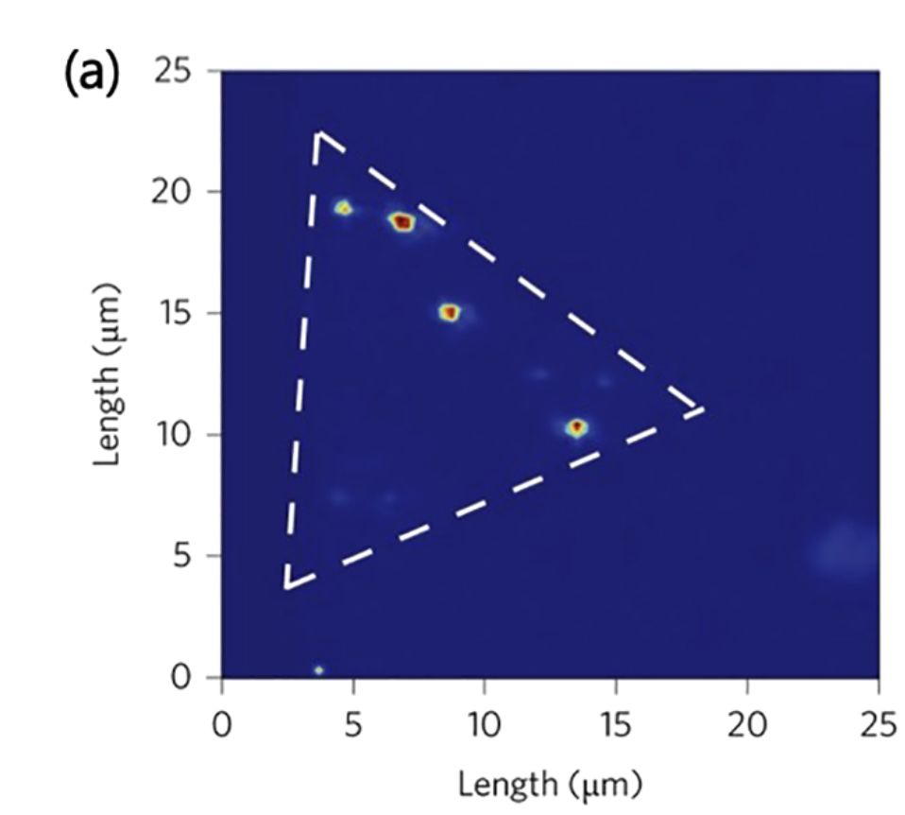
Other Work
Serpentine Motion
Photoluminescence Spectroscopy Map
12

Slide 14
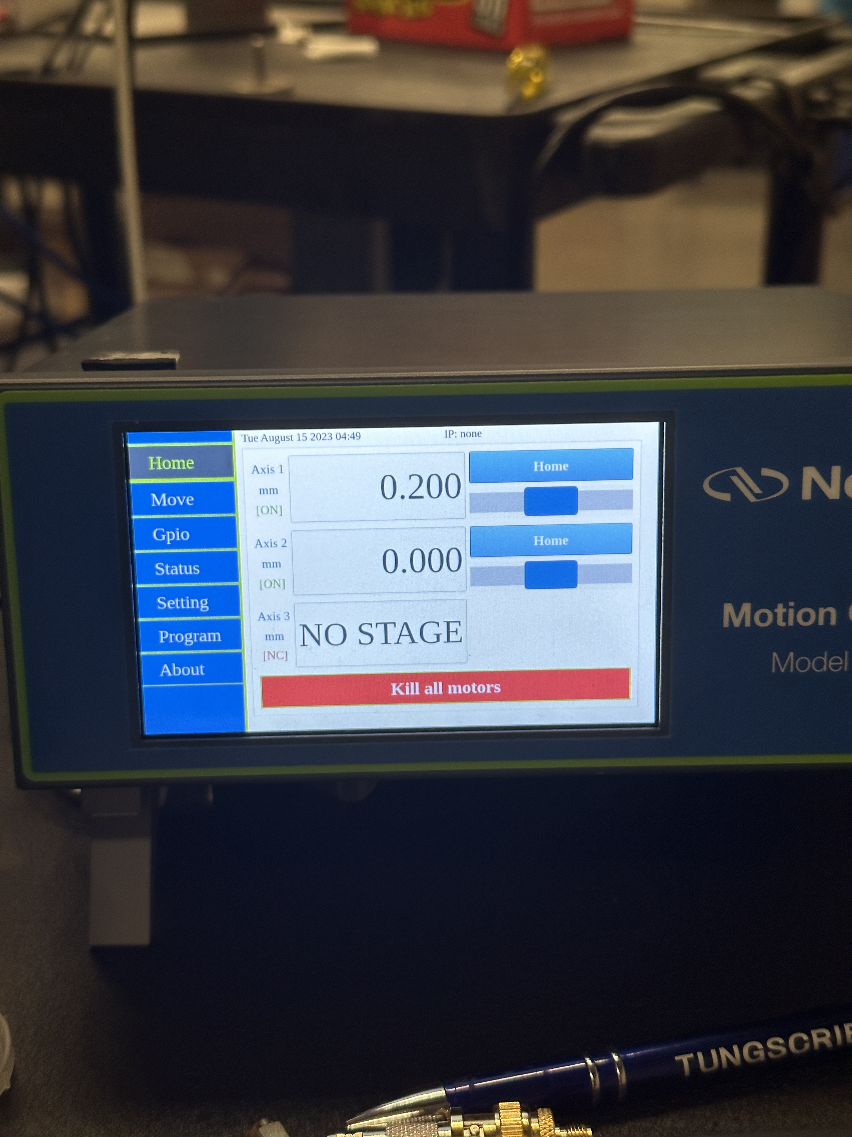
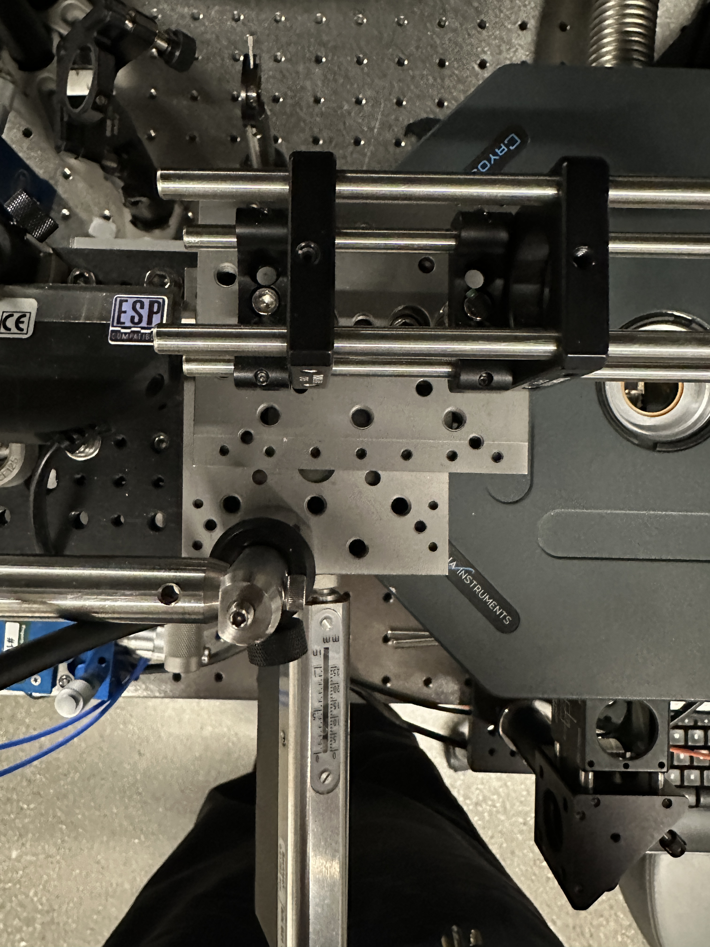
Motion Sweep
Motor Powered Axis
Newport Motion Controller
13

Slide 15
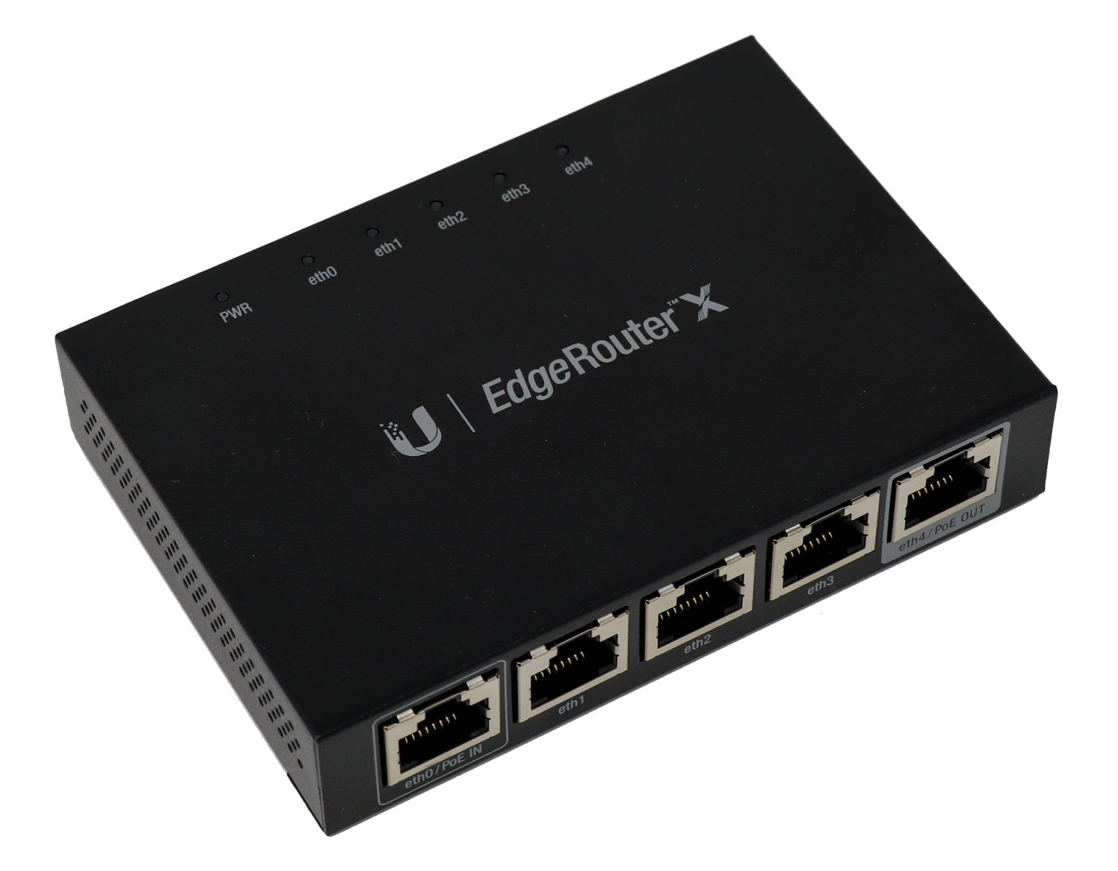
Future Work
Lab Networking Setup
14

Slide 16

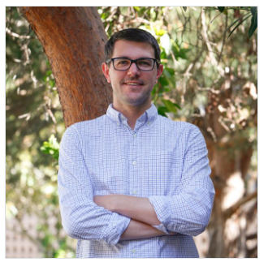


Thank You!
andrewyanez@ucsb.edu
Acknowledgements
LinkedIn
Max Shen
Quynh Dang
Galan Moody
Sahil Patel
15
Notes:
With that, I’d like to thank you for your time, and I’m happy to take any questions if there’s time.

Slide 17
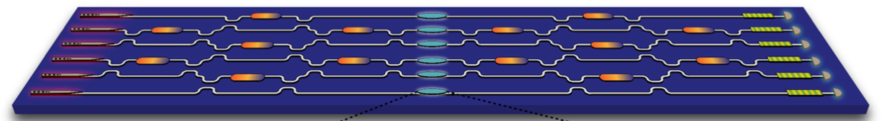

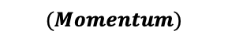

Photoluminescence Spectroscopy
$$E$$
-Single Photon Generation
-The energy bandgap dictates the wavelength of the emitted photon
Direct
Indirect
Energy Band Gap
$$k$$
$$(Momentum)$$

Slide 18
Applications & Impact of Quantum Technologies
USERS/MARKET | COMMUNICATIONS | COMPUTING | SENSING
Fundamental Research | Fundamental tests of quantum mechanics | New materials, algorithms | Imaging, probing decoherence
Medical | Patient confidentiality | Drug discovery | Imaging
Finance & Business | Secure transactions | Faster, more accurate models | Time-keeping
Transportation | Networked vehicles | Traffic optimization | GPS/Navigation
Infrastructure | Protecting infrastructure | Analysis & distribution | Imaging
Networking | Global cryptography | Network optimization | Time-keeping
Optics is a very versatile platform for QIS that can be utilized to teach QIS concepts at the upper undergraduate level
wavelength (nm)
400 600 800 1000 1500 1550 1600
Notes:
Quantum technologies have been of recent interest due to their transformative properties in various sectors such as medicine and healthcare, finance and business, transportation, infrastructure, and networking. Quantum technologies can be categorized under one of three main types, being, communications, computing, and sensing.
PRESS
As shown on the last slide, there are lots of different approaches and platforms for quantum technologies; optics is one such platform that is very versatile due to its Implementation for quantum that can be done at room temperature, making it a very useful platform to teaching QIS concepts.
NEXT

Slide 19
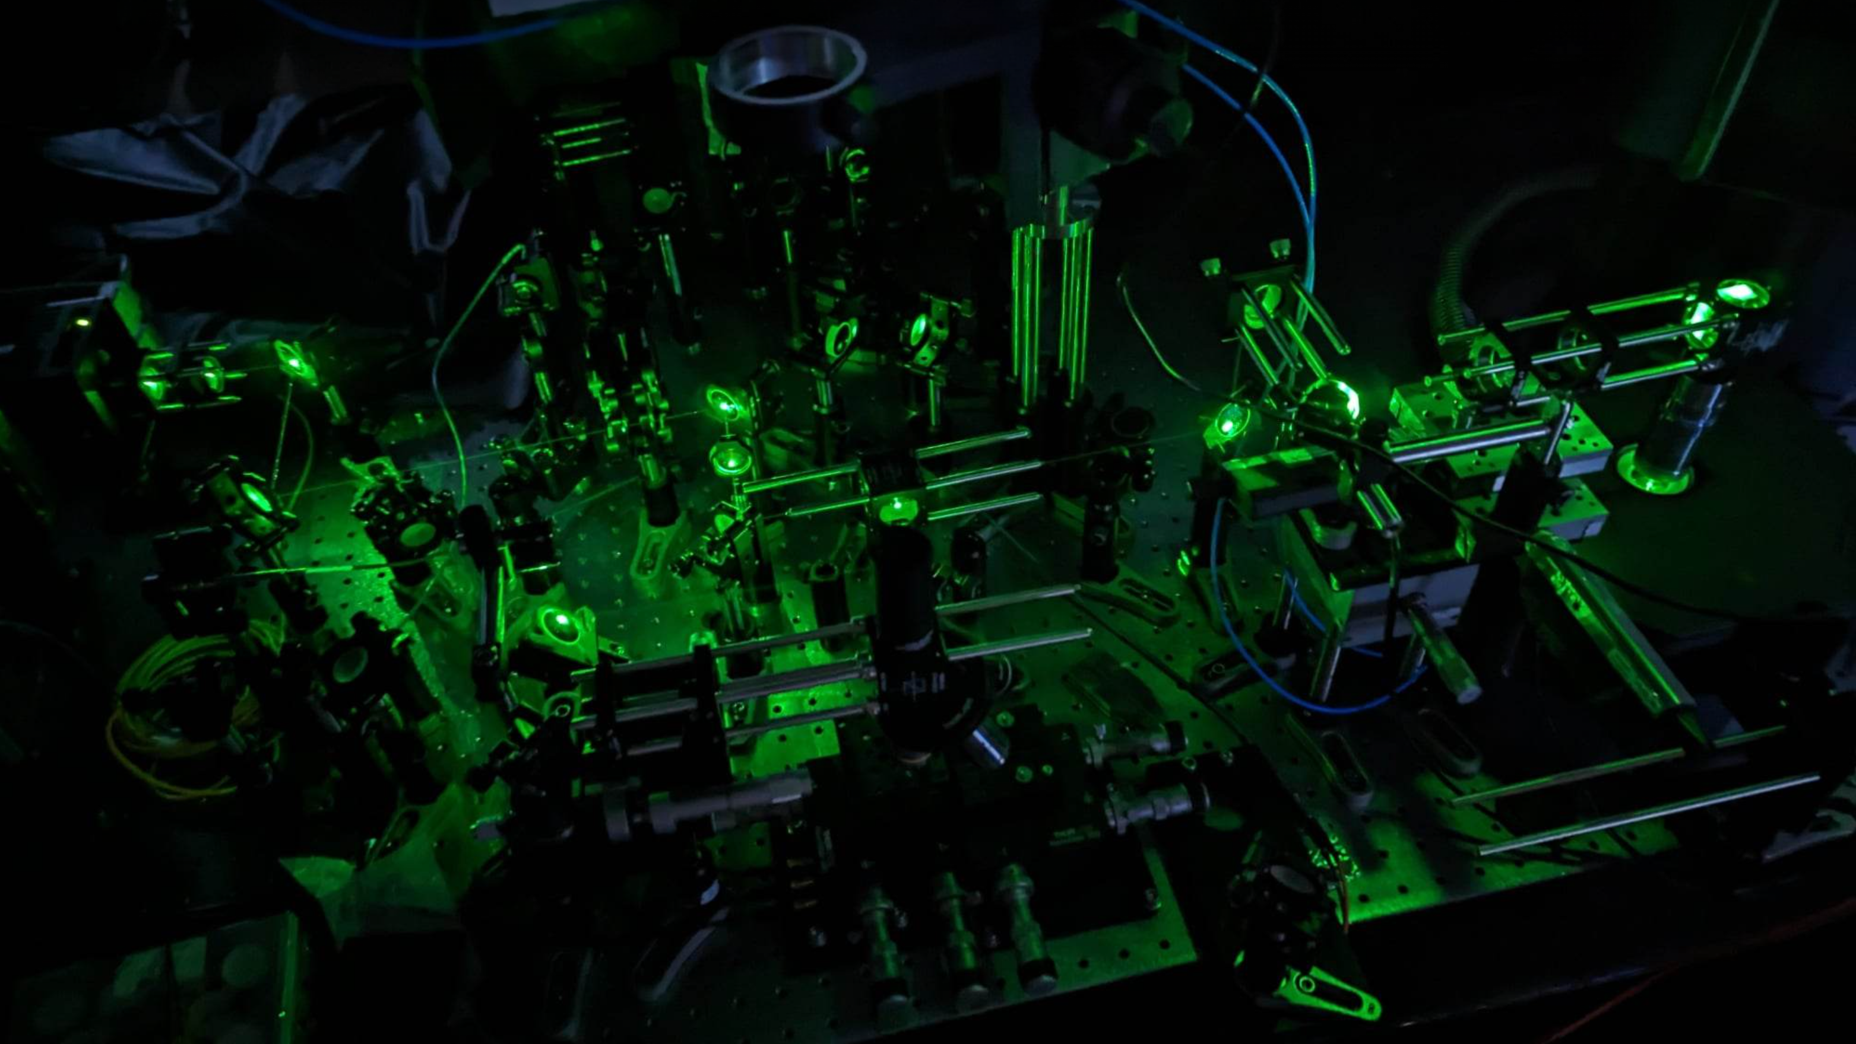
State-of-the-art Spectroscopy Setup
Notes:
Shown here is a state-of-the-art spectroscopy setup that is used for studying optical quantum devices and I wanted to show this just to demonstrate the level of complexity involved. I won’t get into it but this setup involves a cryostat, high frequency digital electronics, nanopositioners, and high power lasers to work. There are a lot of moving parts, a very wide parameter space, and we have to work in the dark. It makes for a cool picture, but its not great for teaching purposes. Its very difficult to learn from when students are focused on the implementation of things instead of the fundamental science.
This is why we use a type-1 SPDC process to study quantum technologies. Because it’s a lot simpler than this, there's less moving parts, and we can have the room lights on! I’ll touch on all of this a little later.
NEXT

Slide 20
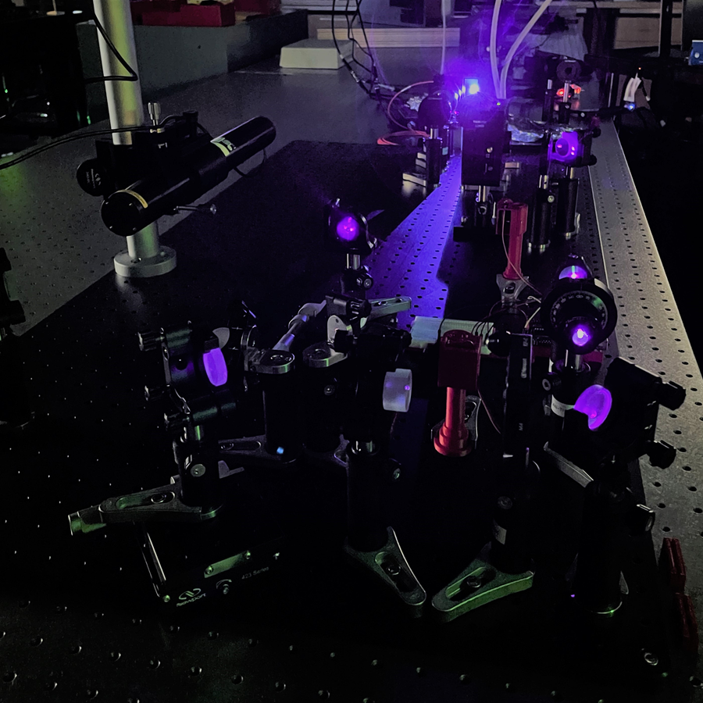
Summary
Developed a fully automated, remotely accessible experimental quantum optics lab course
Created open-source software and utilized 3D-printed components to increase accessibility
Qualitatively show the hands-on aspect of the course increases learning outcomes while simultaneously exposing students to state-of-the-art research equipment
Our open-access setup is a step towards removing the expertise and financial barriers that exist for experimental implementations of quantum education
13
16
Notes:
I’ll summarize quickly. We developed a fully automated remotely accessible experimental quantum optics lab course. We created an open source software and utilized 3D printed components to increase the accessibility.
We also qualitatively show that the hands-on aspect of the course increases learning outcomes, while simultaneously exposing students to state-of-the-art research equipment.
Lastly, our open access setup is a step towards removing the expertise and financial barriers that exist for experimental implementations of quantum education.
NEXT.

